Slide 1
CS440 Foundation of Cybersecurity
Week 5: Public Key Infrastructure

Slide 2
Recap of Week 4
Integrity: to detect whether data is modified by an unauthorized entity
High level idea: message + tag with two principles: (1) tag is generated using a secret; (2) tag is closely bound to message.
Symmetric key based solution:
  HMAC: use a hash function with a key. Understand the three properties of a hash function.
Asymmetric key based solution:
  RSA signatures. Remember the steps of signing and verification.
Understand how to compare HMAC with RSA signatures
Understand how to use RSA signatures and RSA encryption.

Slide 3
Outline
Introduction of the concept of certificates and Public Key Infrastructure (PKI).
Four important procedures.
  certificate request generation (by public key owner)
  certificate issuance (by CA)
  certificate verification (by verifier)
  certificate revocation (by CA)

Slide 4


Consider Hybrid Encryption
Alice
Bob
hybrid encryption
C1=AES-CBC(k, M),
C2=RSA(PK_{Alice}, k)
Public Key Directory
Alice →PK_{Alice}
Bob →PK_{Bob}
Charlie →PK_{Charlie}

Slide 5

The Challenge
What Will Go Wrong if Mallory Replaces Alice’s Public Key with Hers?
Bob
Alice
hybrid encryption
C1=AES-CBC(k, M),
C2=RSA(PK_{Alice}, k)
C2=RSA(PK_{Mallory,} k)
Mallory
Public Key Directory
Alice →PK_{Alice}
Bob →PK_{Bob}
Charlie →PK_{Charlie}
PK_{Mallory}

Slide 6
Consider Digital Signing
Alice
RSA
signature
Bob
message
Hi, meet me at 2PM, …
s
Public Key Directory
Alice →PK_{Alice}
Bob →PK_{Bob}
Charlie →PK_{Charlie}

Slide 7
The Challenge
What if Mallory replaces Alice’s public key with Mallory’s public key?
RSA
signature
Bob
Alice
message
Hi, meet me at 2PM, …
s
Mallory
Public Key Directory
Alice →PK_{Alice}
Bob →PK_{Bob}
Charlie →PK_{Charlie}
PK_{Mallory}

Slide 8
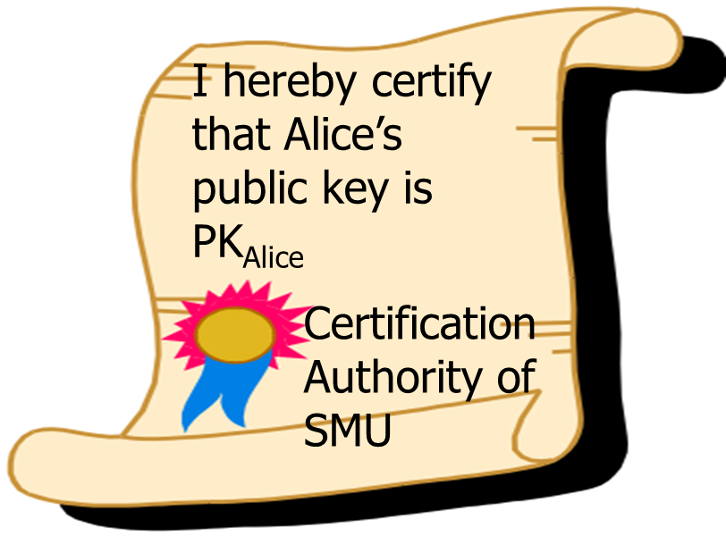
Public key certificate and PKI
Public key certificate:
  a digital token issued by an (trusted) authority to certify the ownership of a public key.
Public Key Infrastructure
  A set of policies, procedures, and products used to implement public key cryptosystem in a large setting. http://www.ietf.org/html.charters/pkix-charter.html
  Core idea: Certificate Authority (CA) issues certificates to public-key holders.
  X.509 standard: A widely used standard for defining and managing digital certificates.

Slide 9
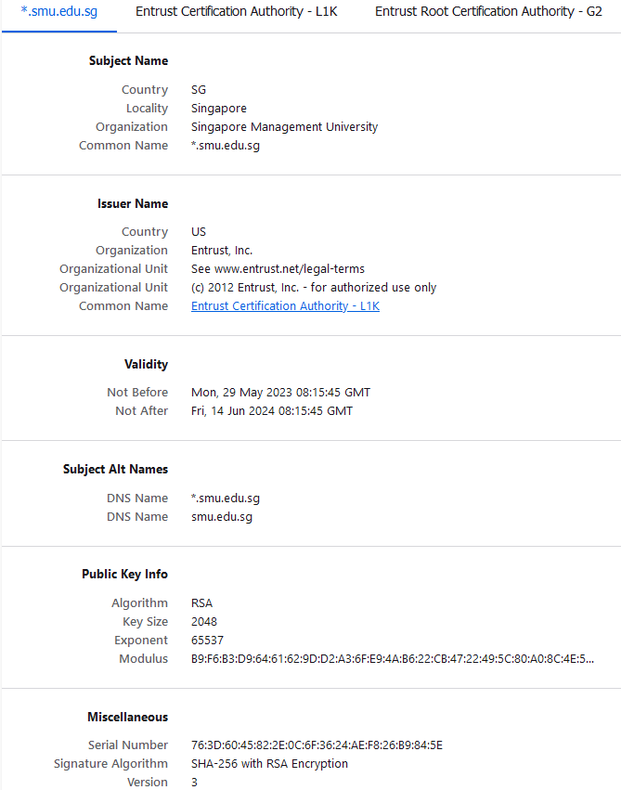
Example: SMU’s Certificate
Find the certificate of www.google.com
Who is the issuer?

Slide 10
Public key certificate contents
Mandatory components in a public key certificate
  the subject identifier: the public key owner’s identity which the certificate is issued to.
  the issuer’s identifier: the Certification Authority (CA) ’s identity
  the public key info: the certified public key (n,e)
  validity period: for how long
  CA’s signature: to show the genuineness of the certificate. (The signature is computed upon the whole certificate data.)
See details from SMU’s certificate (and in lab exercise).

Slide 11
Outline
Introduction of the concept of certificates and Public Key Infrastructure (PKI)
Four important algorithms
  certificate request algorithms (by public key owner and CA)
  certificate issuance algorithm (by CA)
  certificate verification algorithm (by verifier)
  certificate revocation algorithm (by CA)

Slide 12
Certification Request
Alice has generated her RSA key (n,e,d).
Alice wants the CA to certify her (n,e).
  namely to get a certificate on (n,e).
What should Alice send to CA?
CA’s concern (besides verifying Alice’s identity):
I know she is Alice after checking her identity card. But, how do I know (n,e) are indeed her public key? Can Alice can convince me that she knows the corresponding d?
Alice’s concern:
Even though CA is an authority, I don’t wanna tell him my private key. I should be the only person in the world who knows my private key!

Slide 13
Certification Request Generation Algorithm
Alice's RSA public key (n,e) and private key d.
Alice’s certificate request is Alice’s signature on her public key using her private key.
  Let M be the message consisting of n and e.
  Alice signs M to get a signature s
  Alice sends (M,s) to CA as her certificate request.
To verify Alice's request (M,s), CA
  extracts (n,e) from M
  verifies (M,s) using (n,e).
  If the signature (M,s) is valid, the request is approved
    CA is convinced Alice knows d. Otherwise she cannot sign.

Slide 14
Outline
Introduction of the concept of certificates and Public Key Infrastructure (PKI)
Four important algorithms
  certificate request generation algorithm (by public key owner)
  certificate issuance algorithm (by CA)
  certificate verification algorithm (by verifier)
  certificate revocation algorithm (by CA)

Slide 15
Certificate Issuance
CA checks Alice’s identity and verifies Alice’s request using the public key being signed.
If both are correct, CA issues a certificate for Alice’s public key in the following steps:
  Construct the certificate body consisting of the elements defined by the X.509 PKI standard (key elements explained in Slide 10).
  Sign the certificate body with CA's private key.
  Alice's certificate = certificate body + CA's signature
  Alice's certificate is a document signed by CA upon Alice's public key and Alice's identity, as well as other important information.

Slide 16
Outline
Introduction of the concept of certificates and Public Key Infrastructure (PKI)
Four important algorithms
  certificate request generation algorithm (by public key owner)
  certificate issuance algorithm (by CA)
  certificate verification algorithm (by verifier)
  certificate revocation algorithm (by CA)

Slide 17
Certificate Verification
A public key certificate is publicly verifiable, i.e. it can be verified by anyone.
A user obtains a web server's certificate, either by receiving it from the server or retrieving it from some directory.
To verify Alice’s certificate, Bob runs the following steps:
  If it has expired, return false; otherwise,
  verify the signature of the certificate with the certificate body using CA’s public key. If invalid, return false;
  verify whether CA’s public key in use is trusted. If positive, return true; otherwise return false.
    How to verify CA’s public key???
Notes:
Check if url same
Check if it is in the trusted source of CA
Check if it is expired or not
Check if it is in revocation or not

Slide 18

Certification chain
Alice’s CA is certified by another CA.
Alice’s CA’s CA is certified by another CA.
Alice’s CA’s CA’s CA is certified by …
…..
This must be ended at some CA!!

Slide 19
Certification Chain
self-certify
Self-certify:
A CA can self-certify itself by signing its own public key using its private key.
Such a CA is called root CA. A root CA’s certificate is called a self-signed certificate.
Demo: Examples of root CAs in browsers.
MOE CA
certify
SMU CA
certify
To verify Alice’s certificate,
Bob verifies all certificates along the chain (bottom-up), until he reaches the root CA.
Then, he decides whether the root CA is trusted!
SCIS CA
certify
Alice

Slide 20




Use of Certificate in Internet
www.abc.com
Request for Certificate
Here is my cert
www.abc.com
Trusted CAs
1. …
2. …
3.…
4. …
….
To trust or not to trust?
If the cert is for www.abc.com
Y
If the cert is verified as valid
Y
Anyone of its chain is on Trusted CA list?
Y
Accept
N
N
N
N
Y
Abort
Self-signed CA?
Notes:
Compulsory is URL and domain checking with the receiver.
Validity period
Verify the signature
CRL is loosely done.

Slide 21
Trust Or Not Trust?
It boils down to the question of how to establish trust!!
Two approaches for trust establishment
  Most browsers have pre-loaded those root CA certs which are widely considered as trusted, such as Microsoft, Google’s root CA certs.
  You can manually instruct the browser to trust a root CA’s certificate, by inserting the certificate.

Slide 22
Outline
Introduction of the concept of certificates and Public Key Infrastructure (PKI)
Four important algorithms
  certificate request generation algorithm (by public key owner)
  certificate issuance algorithm (by CA)
  certificate verification algorithm (by verifier)
  certificate revocation algorithm (by CA)

Slide 23
Certificate Revocation
What if a private key is compromised?
  ideally, its corresponding public key should not be used any longer.
Basic idea of revocation:
  The authority periodically publishing a black list of those revoked certificates’ serial numbers.
  The black list is called Certificate Revocation List (CRL).
  It is the user’s burden to download the latest CRL.

Slide 24
Certificate Revocation List (CRL)
Signature Alg: RSA+SHA1,1024
Issuer:C=S’pore,O=SMU,OU=SIS
Last Update: 07/01/07
Next Update: 07/02/07
Revoked Certificates
Signature: ………….
Serial Number: 12345…14
Revocation Date: 28/12/06
A CRL is a signed list issued by CA, which contains the serial numbers of revoked certificates.
Serial Number: 12345…21
……

Slide 25
Certificate Verification with CRL
To verify Alice’s certificate Cert={Alice, n,e, Sign_{CA}(Alice,n,e)}, Bob runs the following steps:
  Check if it has expired or not. If not,
  verify the signature Sign_{CA}(Alice, n,e) using CA’s public key;
  verify the entire certification chain;
  check whether Alice’s certificate is in the CRL
Step 4 is not strictly enforced, because of performance and privacy issues!
see: https://www.ssl.com/blogs/how-do-browsers-handle-revoked-ssl-tls-certificates/

Slide 26
Use of Certificate in Internet
www.abc.com
Request for Certificate
Here is my cert
www.abc.com
Trusted CAs
1. …
2. …
3.…
4. …
….
If the cert is for www.abc.com
Y
If the cert is verified as valid
Y
Anyone of its chain is on Trusted CA list?
Accept
Y
N
N
Is it revoked?
N
Y
N
Abort
N
Y
Self-signed CA?

Slide 27






Protocol for Symmetric Key Distribution (revisited)

Slide 28
Protocol for Symmetric Key Distribution (revisited)
Server sends its public key certificate to the client. The cert contains Server’s public key (e.g. an RSA public key).
Client
  verify server’s public key certificate, if ok
  generate a random secret key k (e.g. an AES key)
  encrypt k with Server's public key
  send the ciphertext to Server.
Server decrypts the ciphertext to get k
Hereafter, Server and Client use k to protect their communications.
  encrypt messages using k for confidentiality.
  use HMAC with k to protect integrity

Slide 29
Question
Company ABC sets up its WiFi network with SSID “WLAN_ABC” for its more than 5000 internal users. To prevent external users from accessing WLAN_ABC, a user must submit his/her username and password to the wireless access point for the sake of authentication.
To answer this kind of question, state the technique/method to use and explain how this technique works. Be clear and concise.
Q1: How would you advise Company ABC to prevent its users’ passwords from being stolen by eavesdroppers during Wi-Fi logins?
Q2: Can Company ABC use a self-signed (root CA) certificate for its Wi-Fi access points?

Slide 30
Case Study: Hacking On DigiNotar
Read the article diginotar-hacking.pdf
What is a certificate?
What is the business of DigiNotar
What did the attacker do after hacking DigiNotar?
What is the consequence to the general public?

Slide 31
Take Away
Digital certificate proves the ownership of the public key
Certificates are issued by Certificate Authority (CA), usually a “trusted” third party organization
It contains information about public key, the identity of its owner (called subject), information about the CA (called issuer), and CA’s digital signature over the certificate’s content
If the CA’s signature is valid, the public key contained in the certificate can be used for secure communication with the subject
Root CA is the trusted origin
Security originates from trust

